Slide 1
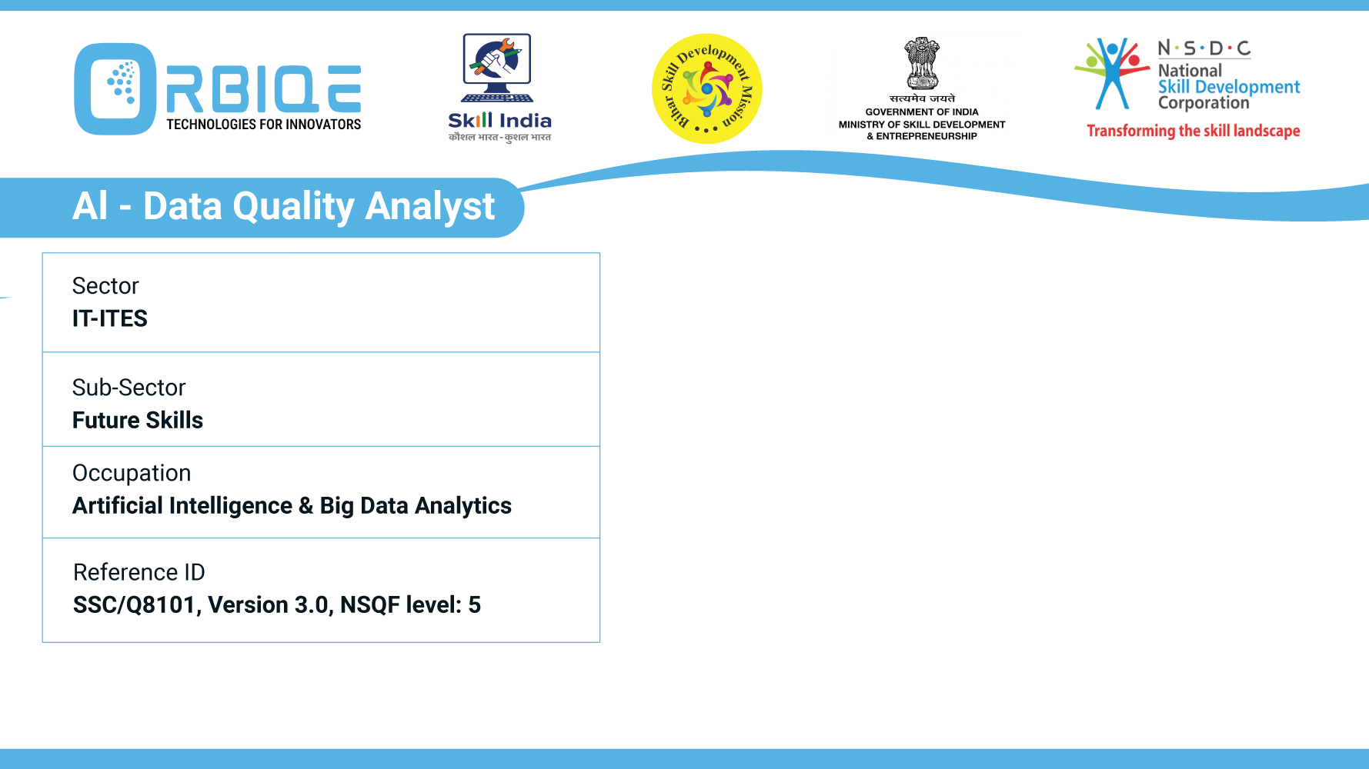
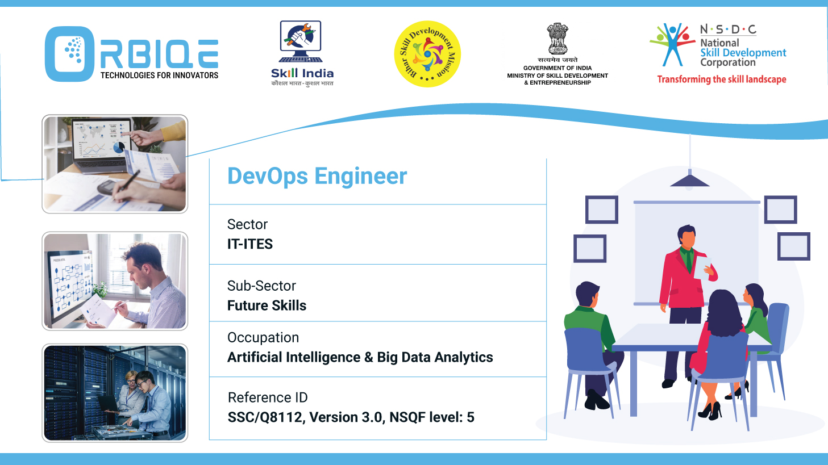
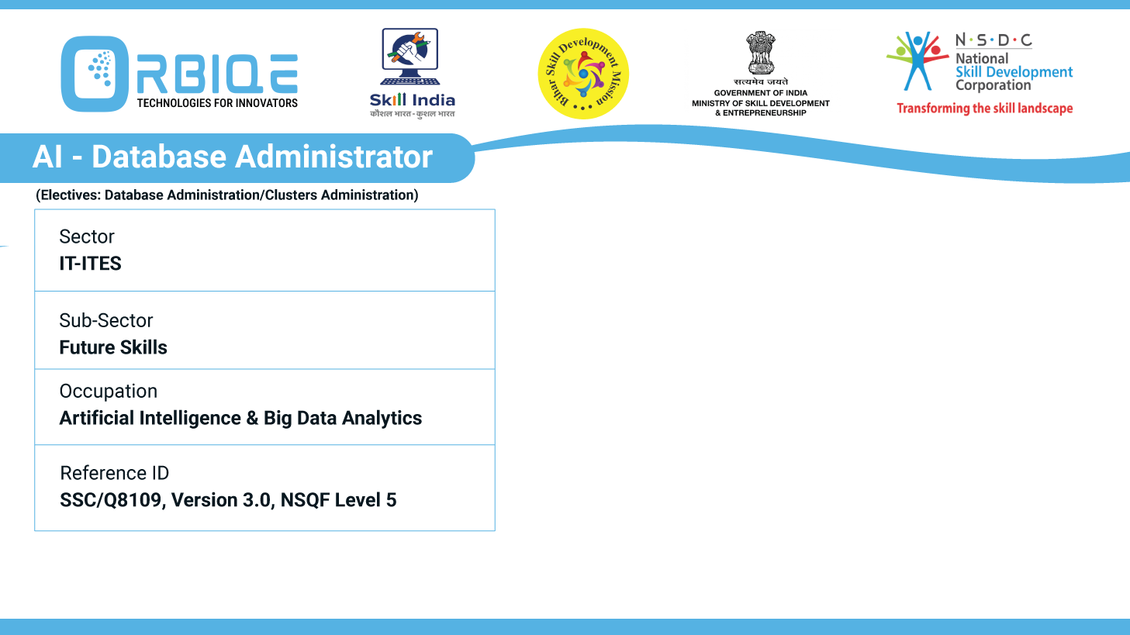
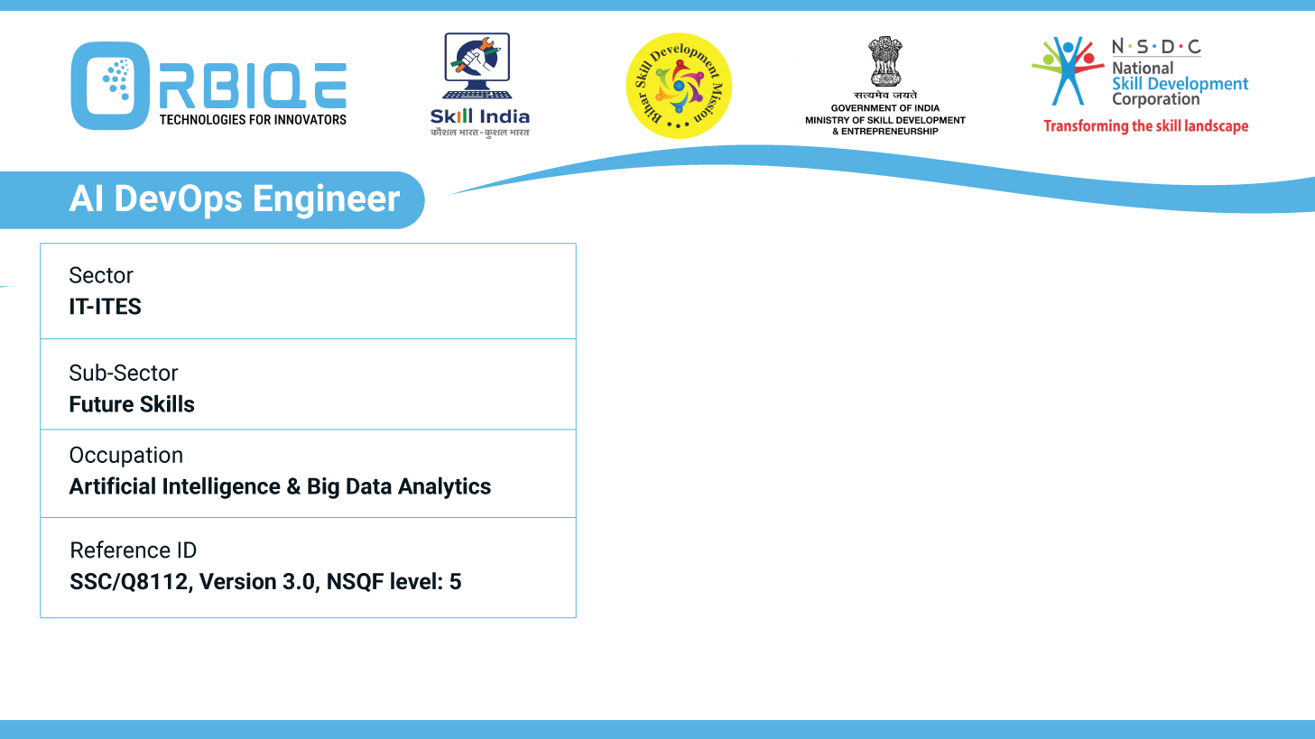
Name- Krishna Kant Dubey

Slide 2

AI and Big Data in Industry

Slide 3
Agenda
Explore and articulate the diverse applications of AI and Big Data across different industries
Providing insights into how these technologies address industry specific challenges and drive innovation

Slide 4
Explore and articulate the diverse applications of AI and Big Data across different industries
Industry | Key AI Appliations
Healthcare | Medical imaging diagnostics, predictive analytics, robotic surgery, virtual assistants
Finance | Fraud detection, algorithmic trading, credit scoring, customer service chatbots
Retail & E-commerce | Personalized recommendations, dynamic pricing, inventory optimization
Manufacturing | Predictive maintenance, quality control, autonomous robots
Transportation | Autonomous vehicles, route optimization, traffic prediction
Education | Adaptive learning platforms, automated grading, career prediction
Entertainment | Content recommendation, deepfake generation, audience sentiment analysis
Legal & Compliance | Contract analysis, legal research automation, risk assessment
Agriculture | Crop monitoring via drones, yield prediction, pest detection
Energy | Smart grid management, consumption forecasting, fault detection

Slide 5
Providing insights into how these technologies address industry specific challenges and drive innovation
Healthcare
Challenge: Diagnostic errors, treatment delays, and resource shortages.
AI Solution: AI-powered imaging tools detect diseases like cancer earlier than human radiologists. Predictive models forecast patient deterioration, enabling proactive care.
Innovation: Personalized medicine—AI tailors treatment plans based on genetic and lifestyle data.

Slide 6
Providing insights into how these technologies address industry specific challenges and drive innovation
Finance
Challenge: Fraud, risk management, and customer churn.
AI Solution: Real-time fraud detection using behavioral analytics; robo-advisors for personalized investment strategies.
Innovation: AI-driven credit scoring models include alternative data like social behavior and transaction patterns.

Slide 7
Providing insights into how these technologies address industry specific challenges and drive innovation
Manufacturing
Challenge: Equipment failure and inefficient production lines.
AI Solution: Predictive maintenance using sensor data reduces downtime and repair costs..
Innovation: Smart factories with autonomous robots and AI-driven quality control systems.

Slide 8
Providing insights into how these technologies address industry specific challenges and drive innovation
Retail
Challenge: Inventory mismanagement and poor customer targeting.
AI Solution: Demand forecasting and dynamic pricing algorithms.
Innovation: Hyper-personalized shopping experiences using AI-powered recommendation engines

Slide 9
Thank You

